Slide 1
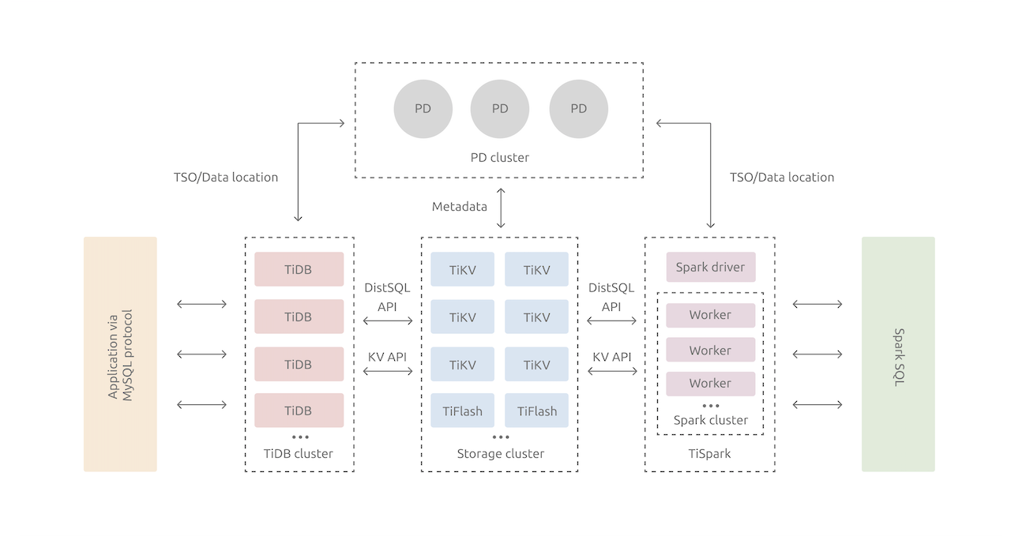
CSC3170 Tutorial
Yifan ZHU

Slide 2
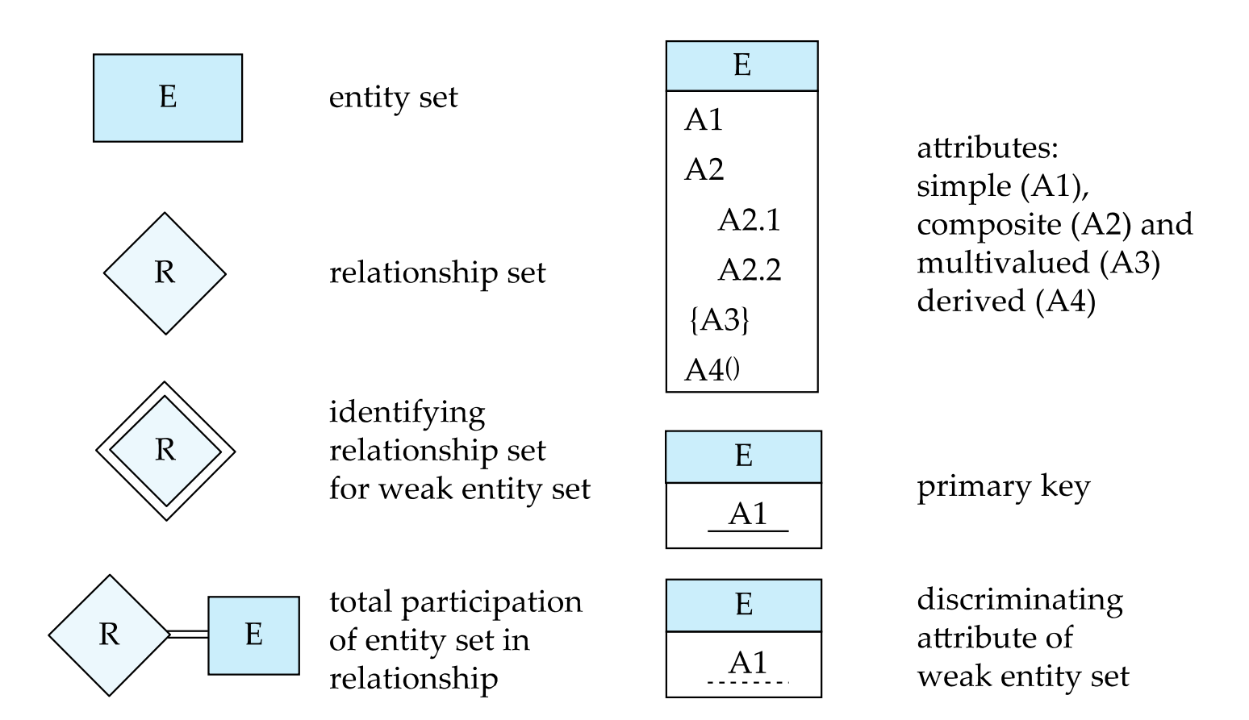

Slide 3
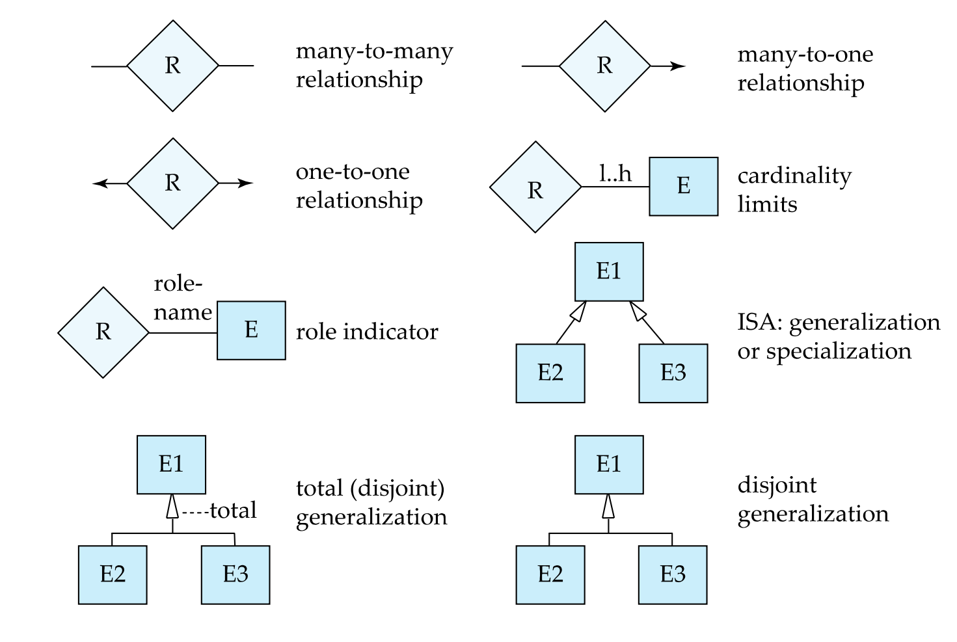

Slide 4
1. Consider a university database, which stores the following information:
students, including student-id, name, and program;
instructors, including identiﬁcation number, name, department, and title;
courses, including number, title, credits, syllabus, and prerequisites;
course offerings, including course number, year, semester, section number, instructor(s), timings, and classroom.
The enrollment of students in courses, and grades awarded to students in each course they are enrolled for should be represented. Supposing that a class meets only at one particular place and time, and that any given room allows multiple class meetings (through partitioning the room).
(a)Design an E-R diagrams for this situation, indicating the data attributes and stating clearly any assumptions that you make.
(b)Construct relational schemas for the above E-R diagram.
(15 marks each)

Slide 5
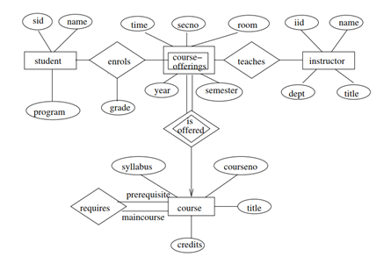
Answer:
(a)

Slide 6
2. Consider the database schema:
STUDENT (Name, Student_number, Class, Major),
COURSE (Course_name, Course_number, Credit_hours, Department),
SECTION (Section_identifier, Course_number, Semester, Year, Instructor),
PREREQUISITE (Course_number, Prerequisite_number),
where example values of Department are: CS, MATH, MUSIC, and example values for Course_number are: CS3130, MATH1003, MUSIC2343 (i.e. each Course_number has the Department as prefix).
a.If the name of the ‘CS’ (Computer Science) Department changes to ‘CSSE’ (Computer Science and Software Engineering) Department and the corresponding prefix for the course number also changes, identify the columns in the database that would need to be changed.
b.Can you restructure the columns in COURSE, SECTION, and PREREQUISITE to reflect the above change?
(10 marks each)

Slide 7
Answer:
a. The following columns will need to be updated. If major is not the department name, then Major in the STUDENT table need not change.
Table | Column(s)
STUDENT | Major
COURSE | Course_number and Department
SECTION | Course_number
PREREQUISITE | Course_number and Prerequisite_number

Slide 8
b. You should split the following columns into two columns:
Table | Column | Split Columns
COURSE | Course_number | CourseDept and CourseNum
SECTION | Course_number | CourseDept and CourseNum
PREREQUISITE | Course_number | CourseDept and CourseNum
PREREQUISITE | Prerequisite_number | PreReqDept and PreReqNum
Note that in the COURSE table, the column CourseDept will not be needed after the above change, since it is redundant with the Department column.

Slide 9
3. Design a generalization–specialization hierarchy for a motor-vehicle sales company. The company sells motorcycles, passenger cars, vans, and buses. Assume that there are the two categories of vehicles: commercial and non-commercial. Note that each vehicle would attract a general sales tax, as well as an additional tax applicable to its category. You should determine the attributes of each entity type and indicate these attributes using appropriate notations. You should state any assumptions you make.
(22 marks)

Slide 10
Answer
The following Figure gives one possible hierarchy, there could be many different solutions. The generalization–specialization hierarchy for the motor-vehicle company is given in the Figure. Model, sales-tax-rate and sales-volume are attributes necessary for all types of vehicles. Commercial vehicles attract commercial vehicle tax, and each kind of commercial vehicle has a passenger carrying capacity speciﬁed for it. Some kinds of non-commercial vehicles attract luxury vehicle tax. Cars alone can be of several types, such as sports-car, sedan, wagon etc., hence the attribute type.

Slide 11
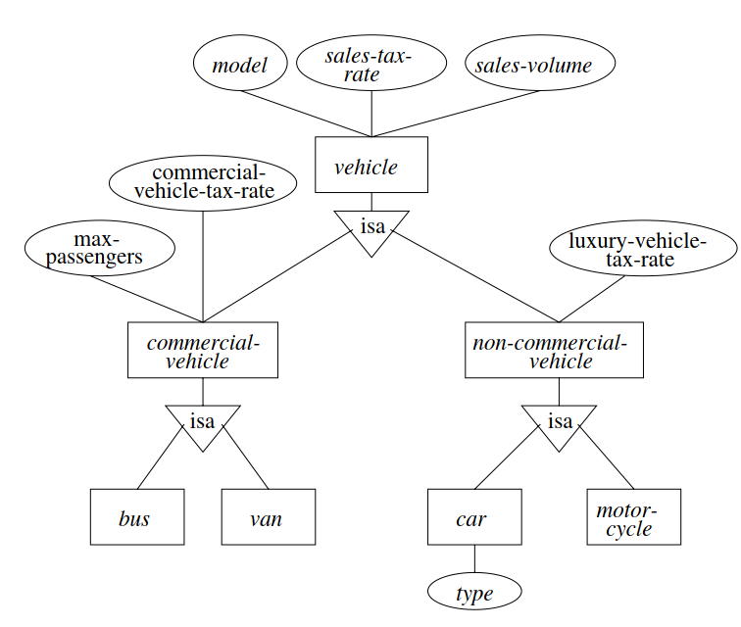

Slide 12
The following are related to Questions 4-10. Consider the following database schema, where the primary keys are underlined.
EMPLOYEE (Fname, Minit, Lname, Ssn, Bdate, Address, Sex, Salary, Super_ssn, Dno)
DEPARTMENT (Dname, Dnumber, Mgr_ssn, Mgr_start_date),
DEPT_LOCATIONS (Dnumber, Dlocation),
WORKS_ON (Essn, Pno, Hours),
PROJECT (Pname, Pnumber, Plocation, Dnum)
DEPENDENT (Essn, Dependent_name, Sex, Bdate, Relationship)
where Fname signifies first name; Minit, middle initial; Lname, last name; Ssn, Essn are social security numbers; Super_ssn is the social security number of the supervisor; Dname, Dnum, Dno, Dlocation are department name, number and location (similarly for projects); while other attributes have an obvious interpretation.
Use Relational Algebra to answer the following queries. You may use any of the Relational Algebra operations, including the natural join.
(4 marks each for the following seven questions)

Slide 13
Answer
4. Retrieve the name and address of all employees who work for the “Research” department.

Slide 14
Answer
5. For every project located in ‘Stafford’, list the project number, the controlling department manager’s last name, address, and birth date.

Slide 15
Answer
6. Make a list of project numbers for projects that involve an employee whose last name is “Smith”, either as a worker or as a manager of the department that controls the project.

Slide 16
Answer
7. Retrieve the names of employees who have no dependents.

Slide 17
Answer
8. List the names of managers who have at least one dependent.

Slide 18
Answer
9. Find all employees directly supervised by “James Borg”.

Slide 19
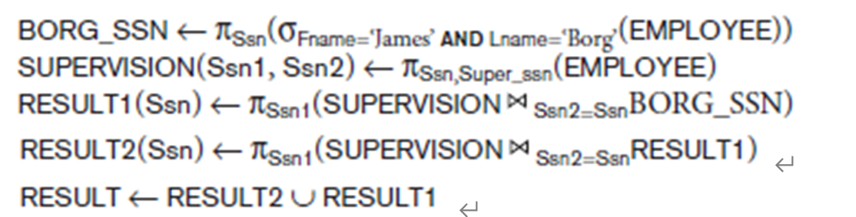
Answer
10. Find all employees directly supervised by those directly supervised by “James Borg”. Would it be possible to find all employees supervised by a given employee at all levels?
No. This is known as a recursive closure operation, and we cannot, in general, specify a query such as “retrieve the supervisees of ‘James Borg’ at all levels” without utilizing a looping mechanism and know the maximum number of levels.

Slide 20
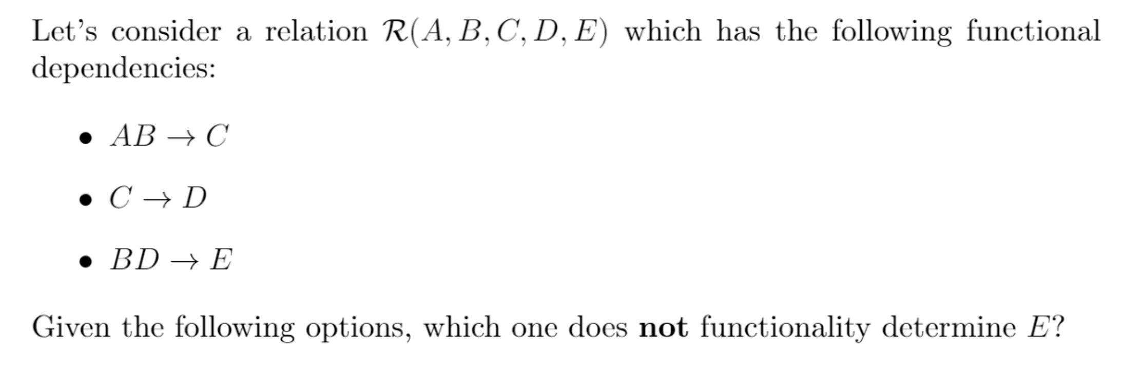
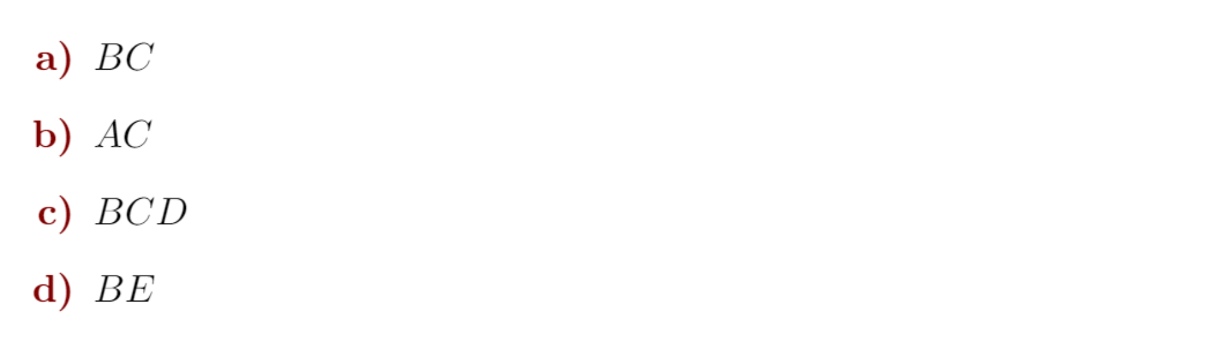

Slide 21
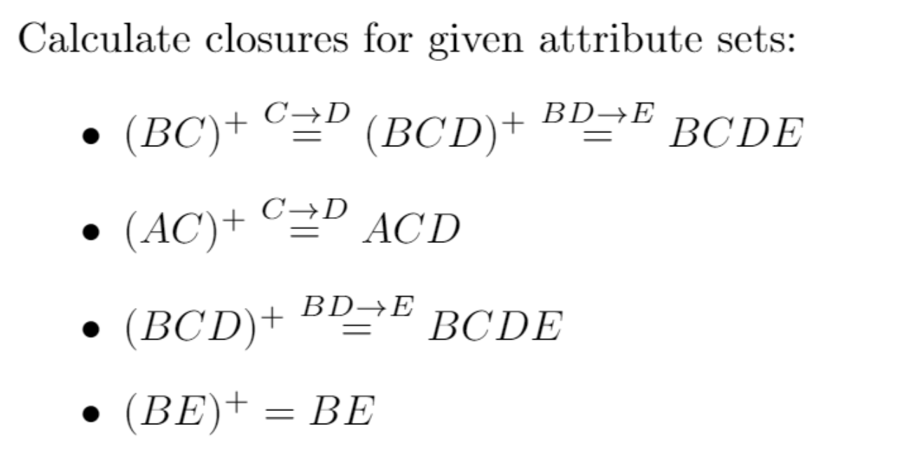

Slide 22
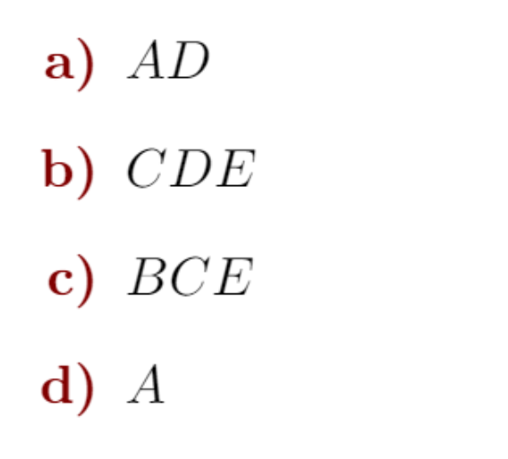
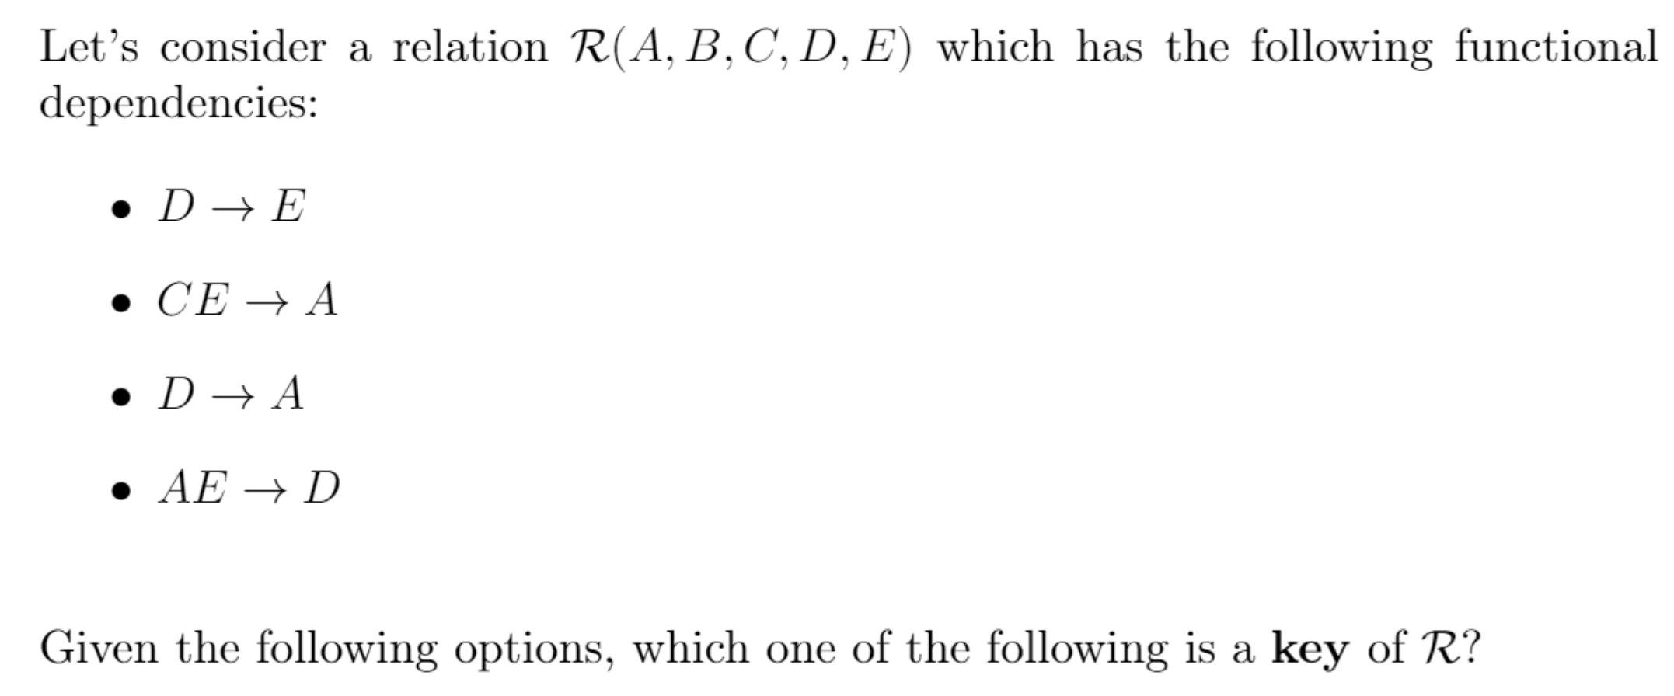

Slide 23
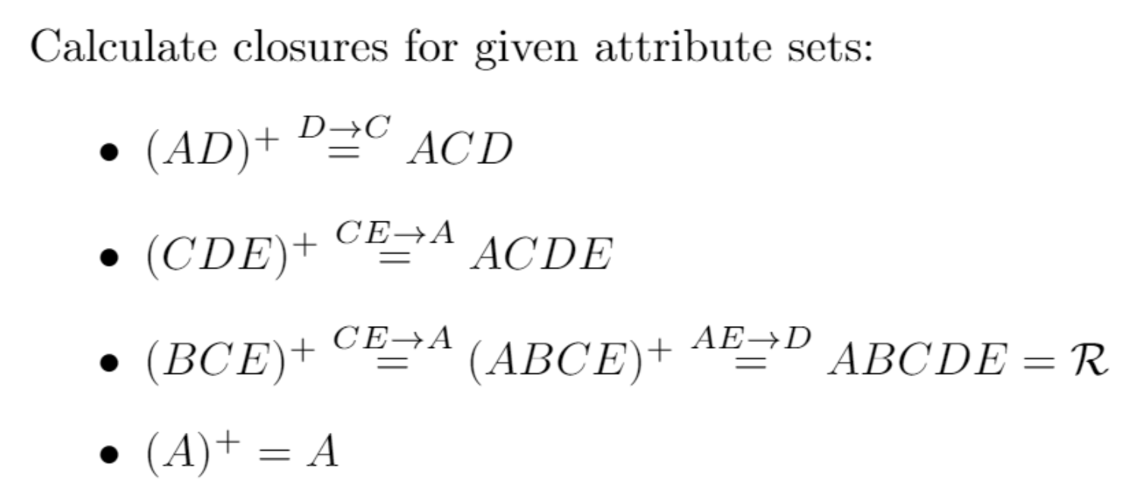

Slide 24
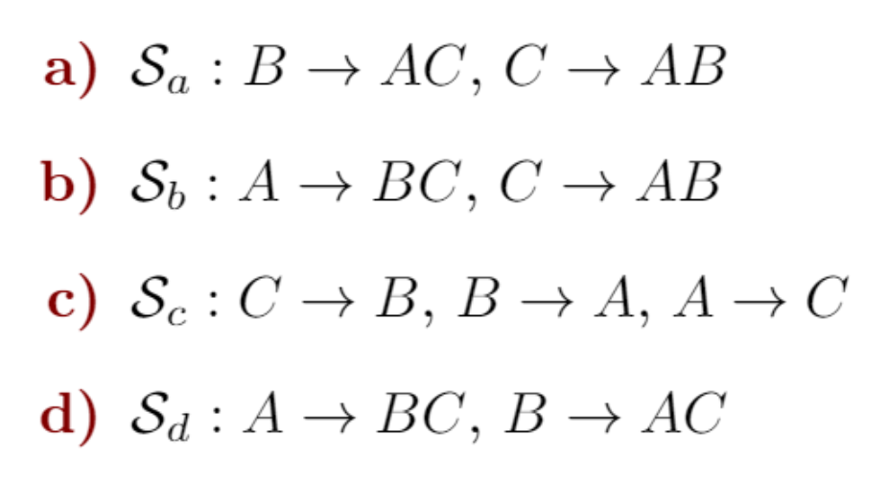
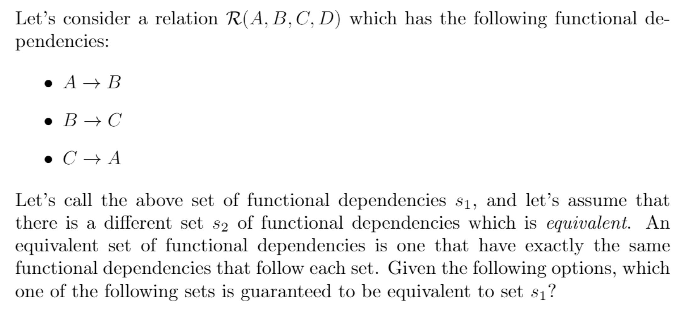

Slide 25
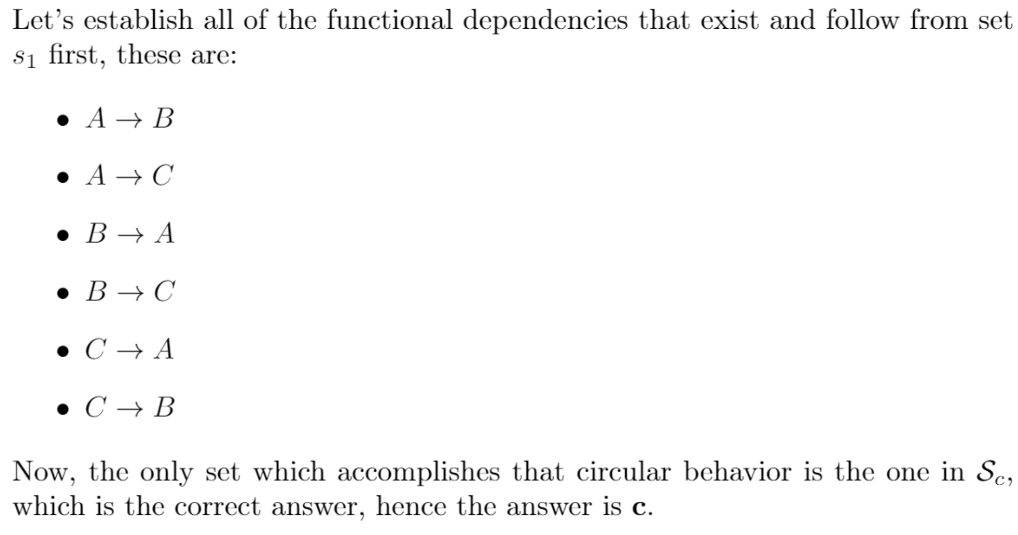

Slide 26
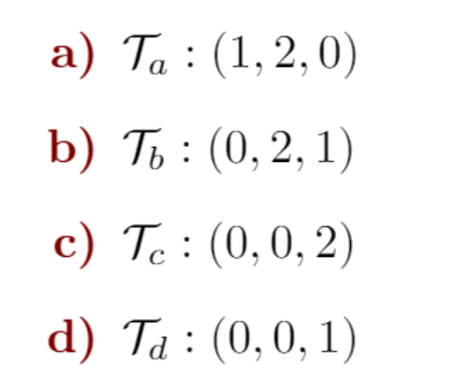
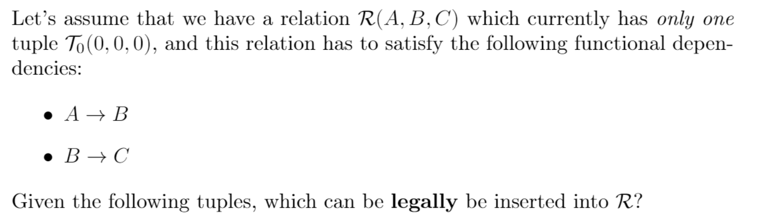

Slide 27
